Slide 1
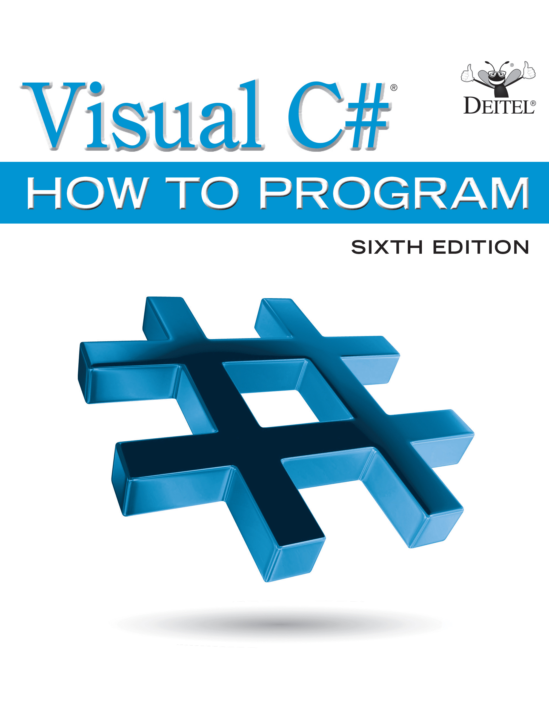
Visual C sharp ® How to Program
Sixth Edition
Chapter 12
O O P: Polymorphism and Interfaces
Slides in this presentation contain hyperlinks. JAWS users should be able to get a list of links by using INSERT+F7
Copyright © 2017 Pearson Education, Inc. All Rights Reserved
Notes:
If this PowerPoint presentation contains mathematical equations, you may need to check that your computer has the following installed:
1) MathType Plugin
2) Math Player (free versions available)
3) NVDA Reader (free versions available)

Slide 2
Learning Objectives
Understand how polymorphism enables you to “program in the general” and make systems extensible.
Use overridden methods to effect polymorphism.
Create abstract classes and methods.
Determine an object’s type at execution time with operator is, then use downcasting to perform type-specific processing.
Create sealed methods and classes.
Declare and implement interfaces.
Be introduced to interfaces IComparable, IComponent, IDisposable and IEnumerator of the .NET Framework Class Library.

Slide 3
Outline (1 of 3)
12.1 Introduction
12.2 Polymorphism Examples
12.3 Demonstrating Polymorphic Behavior
12.4 Abstract Classes and Methods
12.5 Case Study: Payroll System Using Polymorphism
12.5.1 Creating Abstract Base Class Employee
12.5.2 Creating Concrete Derived Class SalariedEmployee

Slide 4
Outline (2 of 3)
12.5.3 Creating Concrete Derived Class HourlyEmployee
12.5.4 Creating Concrete Derived Class CommissionEmployee
12.5.5 Creating Indirect Concrete Derived Class BasePlusCommissionEmployee
12.5.6 Polymorphic Processing, Operator is and Downcasting
12.5.7 Summary of the Allowed Assignments Between Base-Class and Derived-Class Variables
12.6 sealed Methods and Classes

Slide 5
Outline (3 of 3)
12.7 Case Study: Creating and Using Interfaces
12.7.1 Developing an IPayable Hierarchy
12.7.2 Declaring Interface IPayable
12.7.3 Creating Class Invoice
12.7.4 Modifying Class Employee to Implement Interface IPayable
12.7.5 Using Interface IPayable to Process Invoices and Employees Polymorphically
12.7.6 Common Interfaces of the .NET Framework Class Library
12.8 Wrap-Up

Slide 6
12.1 Introduction
Polymorphism enables you to write apps that process objects that share the same base class in a class hierarchy as if they were all objects of the base class.
Polymorphism promotes extensibility.

Slide 7
12.2 Polymorphism Examples (1 of 2)
If class Rectangle is derived from class Quadrilateral, then a Rectangle is a more specific version of a Quadrilateral.
Any operation that can be performed on a Quadrilateral object can also be performed on a Rectangle object.
These operations also can be performed on other Quadrilaterals, such as Squares, Parallelograms and Trapezoids.
The polymorphism occurs when an app invokes a method through a base-class variable.

Slide 8
12.2 Polymorphism Examples (2 of 2)
As another example, suppose we design a video game that manipulates objects of many different types, including objects of classes Martian, Venusian, Plutonian, SpaceShip and La­serBeam.
Each class inherits from the common base class SpaceObject, which contains method Draw.
A screen-manager app maintains a collection (e.g., a SpaceObject array) of references to objects of the various classes.
To refresh the screen, the screen manager periodically sends each object the same message—namely, Draw, while object responds in a unique way.

Slide 9
Software Engineering Observation 12.1
Polymorphism promotes extensibility: Software that invokes polymorphic behavior is independent of the object types to which messages are sent. New object types that can respond to existing method calls can be incorporated into a system without requiring modification of the polymorphic system logic. Only client code that instantiates new objects must be modified to accommodate new types.

Slide 10
12.3 Demonstrating Polymorphic Behavior (1 of 3)
In a method call on an object, the type of the actual referenced object, not the type of the reference, determines which method is called.
An object of a derived class can be treated as an object of its base class.
A base-class object is not an object of any of its derived classes.
The is-a relationship applies from a derived class to its direct and indirect base classes, but not vice versa.

Slide 11
Software Engineering Observation 12.2
The is-a relationship applies from a derived class to its direct and indirect base classes, but not vice versa.

Slide 12
12.3 Demonstrating Polymorphic Behavior (2 of 3)
The compiler allows the assignment of a base-class reference to a derived-class variable if we explicitly cast the base-class reference to the derived-class type.
If an app needs to perform a derived-class-specific operation on a derived-class object referenced by a base-class variable, the app must first cast the base-class reference to a derived-class reference through a technique known as downcasting. This enables the app to invoke derived-class methods that are not in the base class.
Figure 12.1 demonstrates three ways to use base-class and derived-class variables.

Slide 13
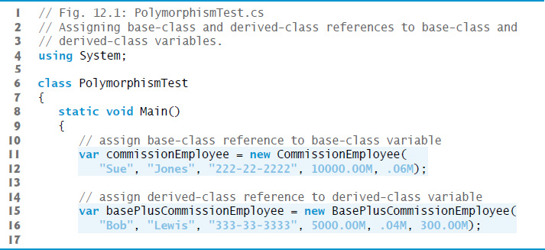
Figure 12.1 Assigning Base-Class and Derived-Class References to Base-Class and Derived-Class Variables (1 of 5)

Slide 14
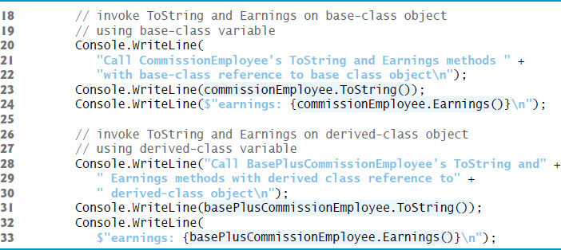
Figure 12.1 Assigning Base-Class and Derived-Class References to Base-Class and Derived-Class Variables (2 of 5)

Slide 15
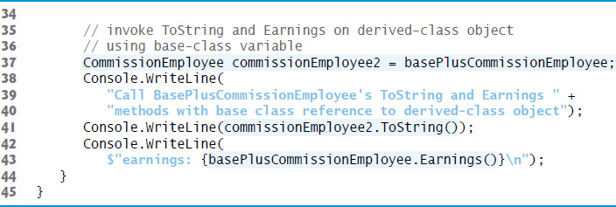
Figure 12.1 Assigning Base-Class and Derived-Class References to Base-Class and Derived-Class Variables (3 of 5)

Slide 16
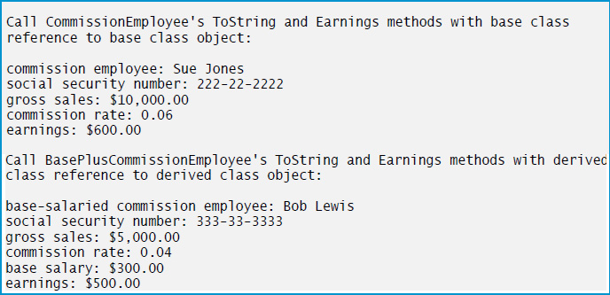
Figure 12.1 Assigning Base-Class and Derived-Class References to Base-Class and Derived-Class Variables (4 of 5)

Slide 17
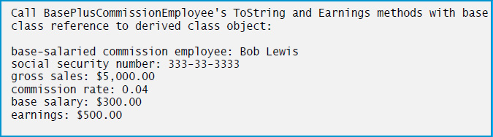
Figure 12.1 Assigning Base-Class and Derived-Class References to Base-Class and Derived-Class Variables (5 of 5)

Slide 18
12.3 Demonstrating Polymorphic Behavior (3 of 3)
When the compiler encounters a virtual method call made through a variable, the compiler checks the variable’s class type to determines if the method can be called.
At execution time, the type of the object to which the variable refers determines the actual method to use.

Slide 19
Software Engineering Observation 12.3
A base-class variable that contains a reference to a derived-class object and is used to call a virtual method actually calls the overriding derived-class version of the method.

Slide 20
12.4 Abstract Classes and Methods (1 of 5)
Abstract classes, or abstract base classes cannot be used to instantiate objects.
Abstract base classes are too general to create real objects—they specify only what is common among derived classes.
Classes that can be used to instantiate objects are called concrete classes.
Concrete classes provide the specifics that make it reasonable to instantiate objects.

Slide 21
12.4 Abstract Classes and Methods (2 of 5)
An abstract class normally contains one or more abstract methods, which have the keyword abstract in their declaration.
A class that contains abstract methods must be declared as an abstract class even if it contains concrete (non-abstract) methods.
Abstract methods do not provide implementations.

Slide 22
12.4 Abstract Classes and Methods (3 of 5)
Abstract property declarations have the form:
public abstract PropertyType MyProperty { get; set; }
An abstract property omits implementations for the get accessor and/or the set accessor.
Concrete derived classes must provide implementations for every accessor declared in the abstract property.

Slide 23
12.4 Abstract Classes and Methods (4 of 5)
Constructors and static methods cannot be declared abstract or virtual

Slide 24
Software Engineering Observation 12.4
An abstract class declares common attributes and behaviors of the various classes that inherit from it, either directly or indirectly, in a class hierarchy. An abstract class typically contains one or more abstract methods or properties that concrete derived classes must override. The instance variables, concrete methods and concrete properties of an abstract class are subject to the normal rules of inheritance.

Slide 25
Common Programming Error 12.1
Attempting to instantiate an object of an abstract class is a compilation error.

Slide 26
Common Programming Error 12.2
Failure to implement a base class’s abstract methods and properties in a derived class is a compilation error unless the derived class is also declared abstract.

Slide 27
12.4 Abstract Classes and Methods (5 of 5)
We can use abstract base classes to declare variables that can hold references to objects of any concrete classes derived from those abstract classes.
You can use such variables to manipulate derived-class objects polymorphically and to invoke static methods declared in those abstract base classes.

Slide 28
12.5 Case Study: Payroll System Using Polymorphism (1 of 4)
A company pays its employees on a weekly basis. The employees are of four types:
Salaried employees are paid a fixed weekly salary regardless of the number of hours worked,
hourly employees are paid by the hour and receive "time-and-a-half" overtime pay for all hours worked in excess of 40 hours,
commission employees are paid a percentage of their sales, and
salaried-commission employees receive a base salary plus a percentage of their sales.
For the current pay period, the company has decided to reward salaried-commission employees by adding 10% to their base salaries. The company wants to implement an app that performs its payroll calculations polymorphically.

Slide 29
12.5 Case Study: Payroll System Using Polymorphism (2 of 4)
We use abstract class Employee to represent the general concept of an employee.
SalariedEmployee, CommissionEmployee and HourlyEmployee extend Employee.
Class BasePlusCommissionEmployee—which extends CommissionEmployee—represents the last employee type.

Slide 30
12.5 Case Study: Payroll System Using Polymorphism (3 of 4)
The U M L class diagram in Figure 12.2 shows the inheritance hierarchy for our polymorphic employee payroll app.

Slide 31
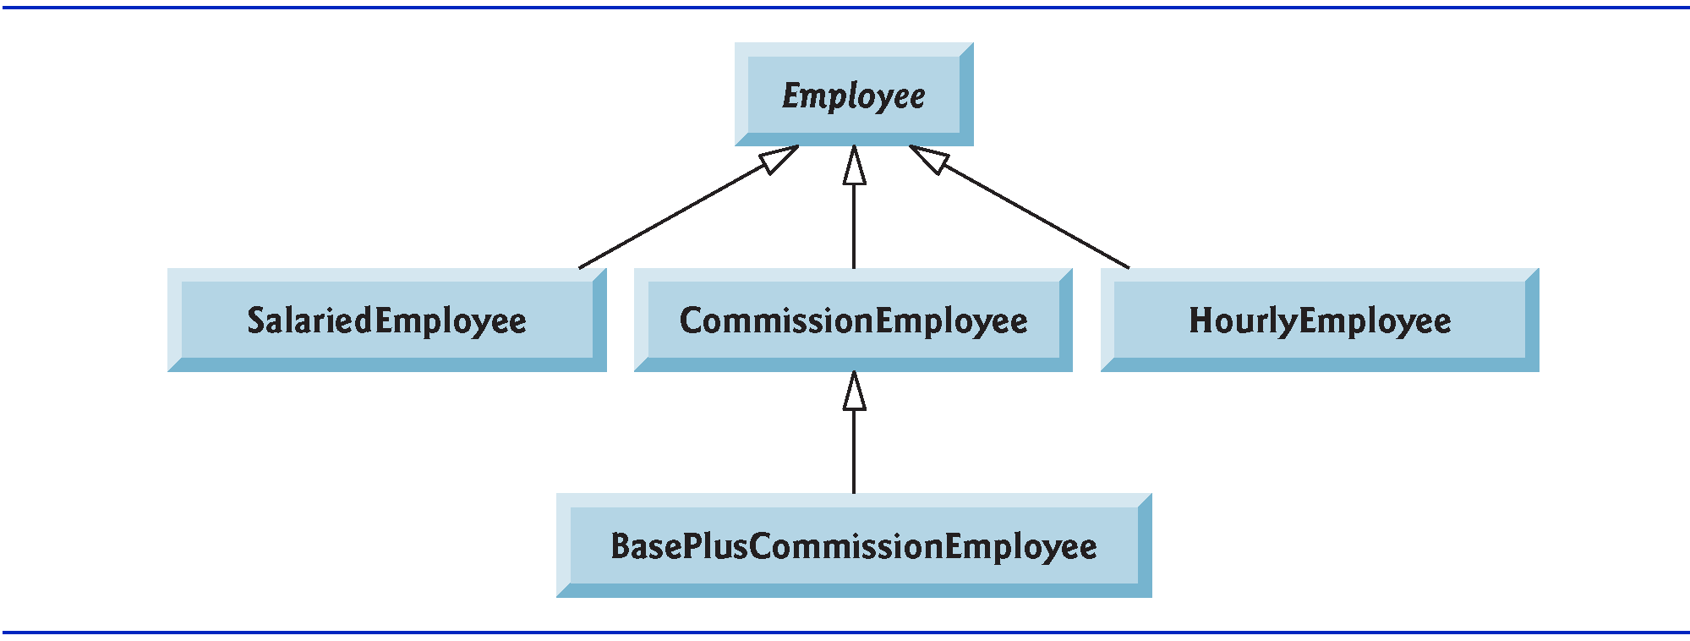
Figure 12.2 Employee Hierarchy U M L Class Diagram

Slide 32
12.5.1 Creating Abstract Base Class Employee
Class Employee provides methods Earnings and ToString, in addition to the properties that manipulate Employee’s instance variables.
Each earnings calculation depends on the employee’s class, so we declare Earnings as abstract.
The app iterates through the array and calls method Earnings for each Employee object. These method calls are processed polymorphically.
Each derived class overrides method ToString to create a string representation of an object of that class.

Slide 33
12.5 Case Study: Payroll System Using Polymorphism (4 of 4)
The diagram in Figure 12.3 shows each of the five classes in the hierarchy down the left side and methods Earnings and ToString across the top.
The Employee class’s declaration is shown in Figure 12.4 (see slide 36).

Slide 34
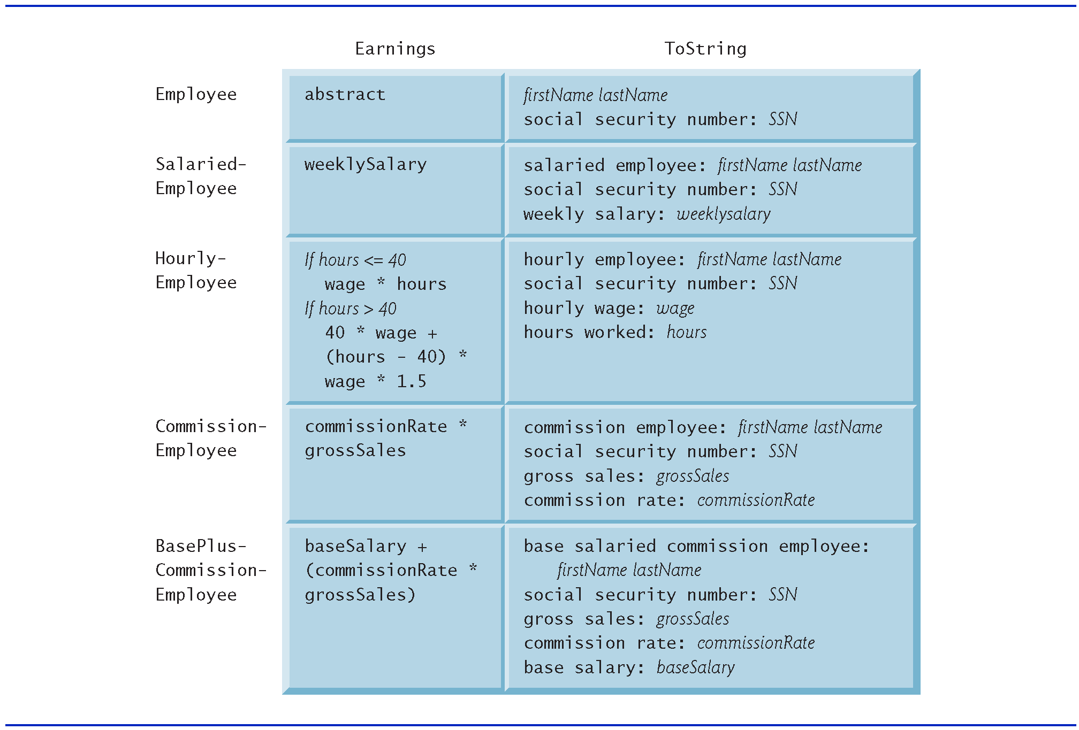
Figure 12.3 Polymorphic Interface for the Employee Hierarchy Classes

Slide 35
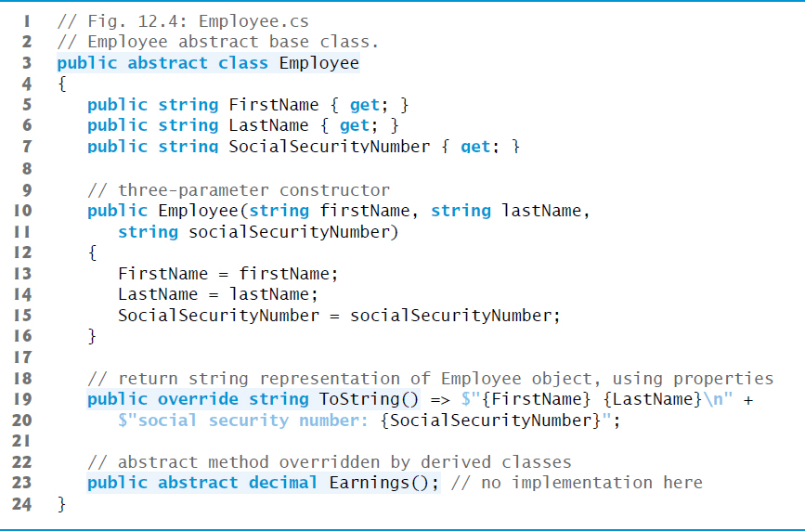
Figure 12.4 Employee Abstract Base Class

Slide 36
12.5.2 Creating Concrete Derived Class SalariedEmployee
The SalariedEmployee class’s declaration is shown in Figure 12.5.

Slide 37
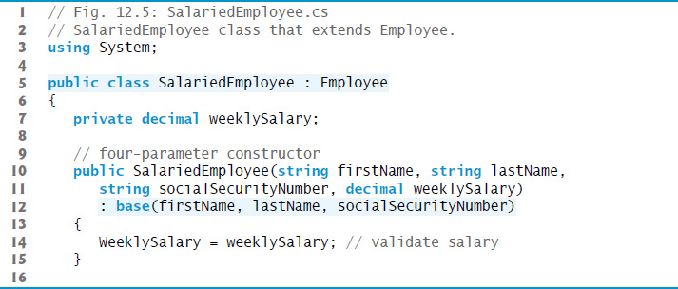
Figure 12.5 SalariedEmployee Class that Extends Employee (1 of 3)

Slide 38
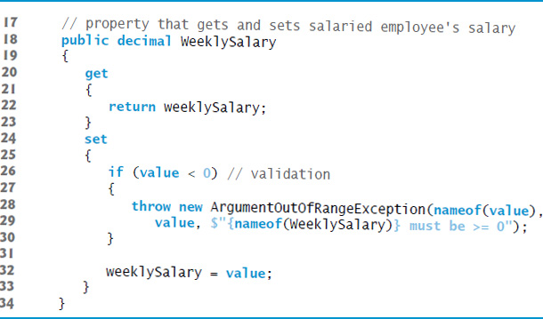
Figure 12.5 SalariedEmployee Class that Extends Employee (2 of 3)

Slide 39
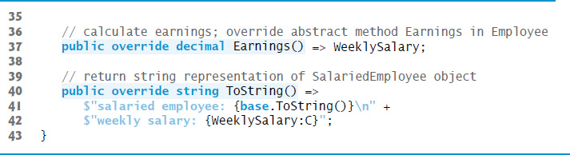
Figure 12.5 SalariedEmployee Class that Extends Employee (3 of 3)

Slide 40
12.5.3 Creating Concrete Derived Class HourlyEmployee
The HourlyEmployee class’s declaration is shown in Figure 12.6.

Slide 41
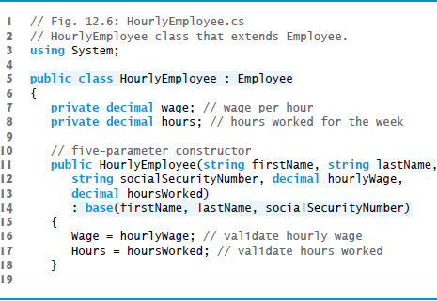
Figure 12.6 HourlyEmployee Class that Extends Employee (1 of 4)

Slide 42
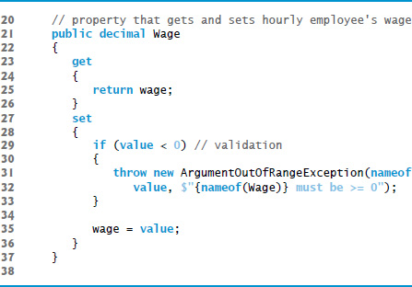
Figure 12.6 HourlyEmployee Class that Extends Employee (2 of 4)

Slide 43
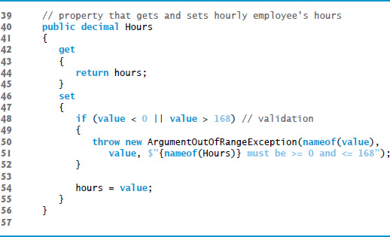
Figure 12.6 HourlyEmployee Class that Extends Employee (3 of 4)

Slide 44
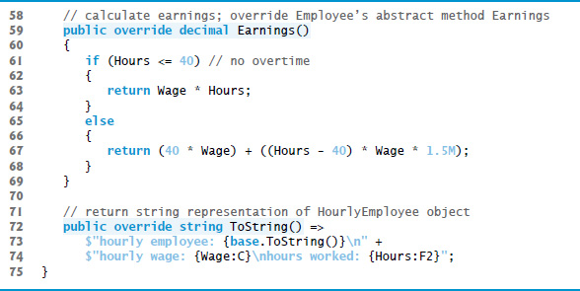
Figure 12.6 HourlyEmployee Class that Extends Employee (4 of 4)

Slide 45
12.5.4 Creating Concrete Derived Class CommissionEmployee
The CommissionEmployee class’s declaration is shown in Figure 12.7.

Slide 46
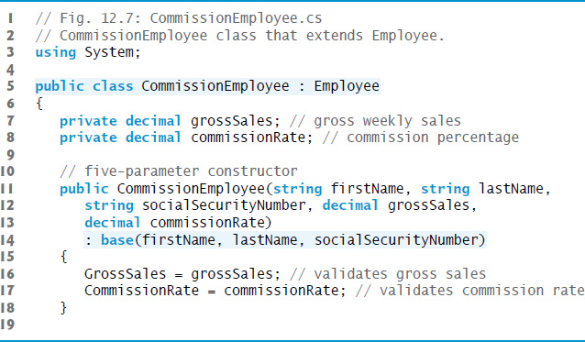
Figure 12.7 CommissionEmployee Class That Extends Employee (1 of 4)

Slide 47
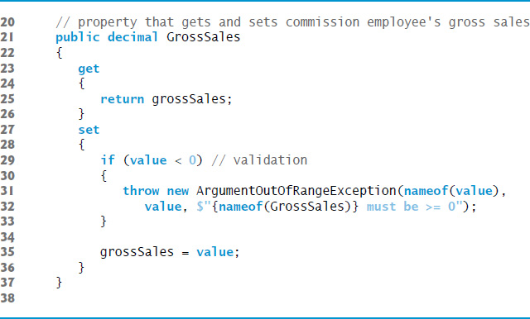
Figure 12.7 CommissionEmployee Class That Extends Employee (2 of 4)

Slide 48
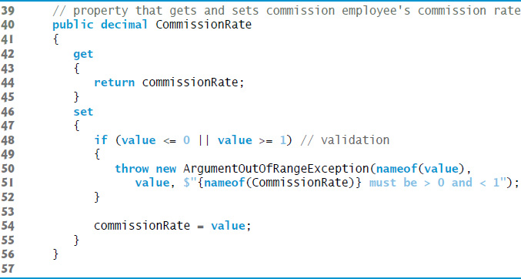
Figure 12.7 CommissionEmployee Class That Extends Employee (3 of 4)

Slide 49
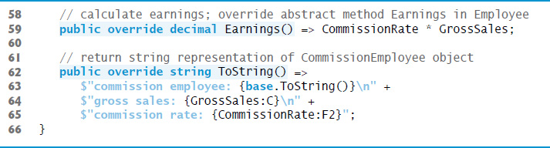
Figure 12.7 CommissionEmployee Class That Extends Employee (4 of 4)

Slide 50
12.5.5 Creating Indirect Concrete Derived Class BasePlusCommissionEmployee
Class BasePlusCommissionEmployee (Figure 2.8) extends class Commission­Employee and therefore is an indirect derived class of class Employee.

Slide 51
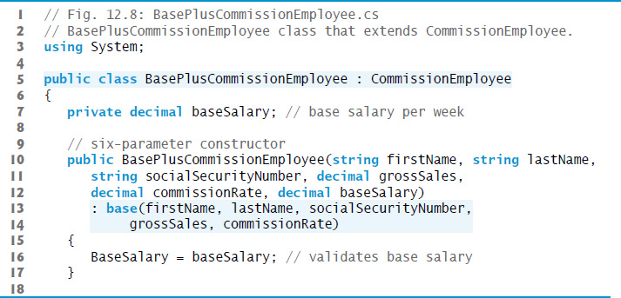
Figure 12.8 BasePlusCommissionEmployee Class That Extends CommissionEmployee (1 of 3)

Slide 52
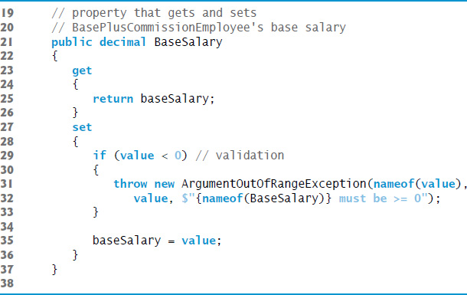
Figure 12.8 BasePlusCommissionEmployee Class That Extends CommissionEmployee (2 of 3)

Slide 53
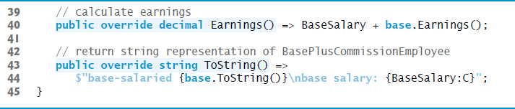
Figure 12.8 BasePlusCommissionEmployee Class That Extends CommissionEmployee (3 of 3)

Slide 54
12.5.6 Polymorphic Processing, Operator is and Downcasting (1 of 2)
The app in Figure 12.9 tests our Employee hierarchy.

Slide 55
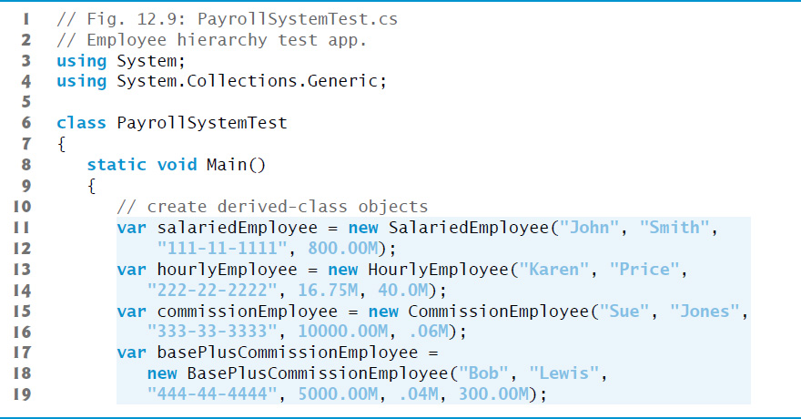
Figure 12.9 Employee Hierarchy Test App (1 of 7)

Slide 56
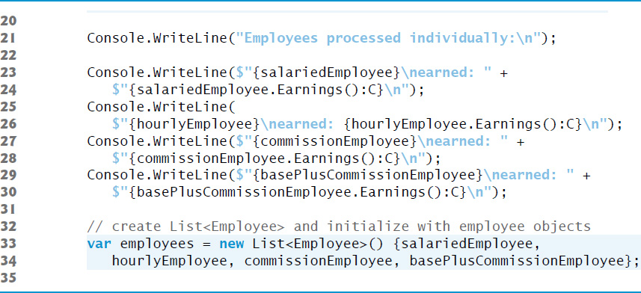
Figure 12.9 Employee Hierarchy Test App (2 of 7)

Slide 57
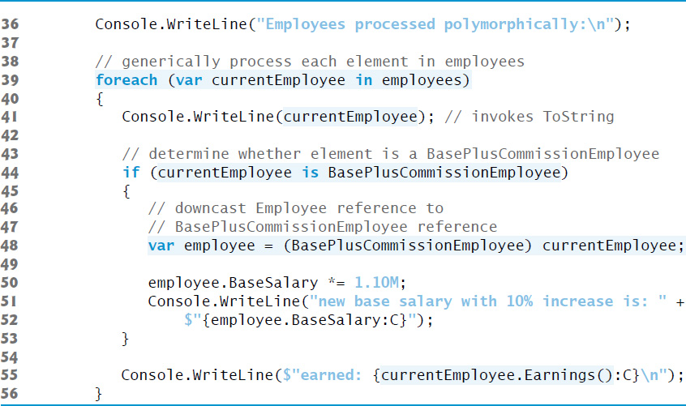
Figure 12.9 Employee Hierarchy Test App (3 of 7)

Slide 58
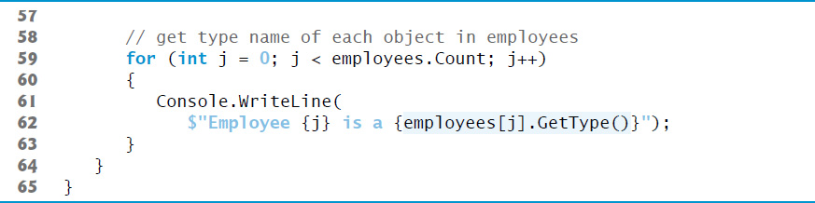
Figure 12.9 Employee Hierarchy Test App (4 of 7)

Slide 59
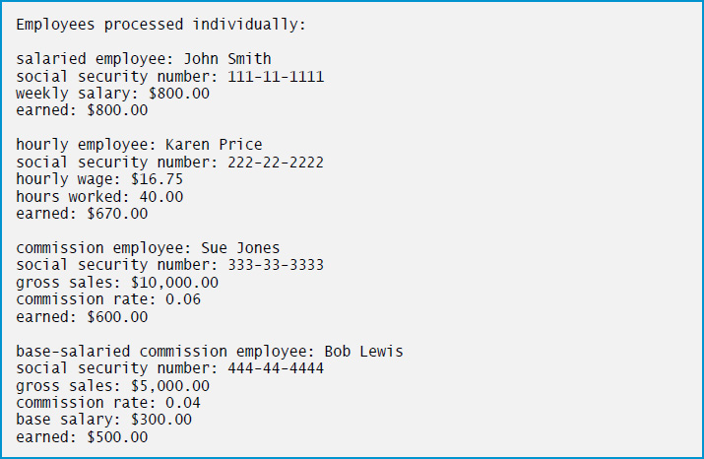
Figure 12.9 Employee Hierarchy Test App (5 of 7)

Slide 60
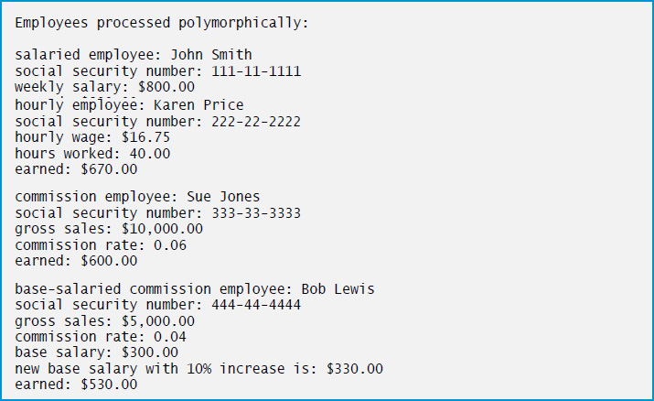
Figure 12.9 Employee Hierarchy Test App (6 of 7)

Slide 61
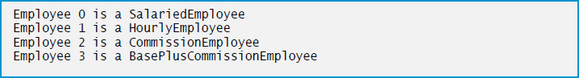
Figure 12.9 Employee Hierarchy Test App (7 of 7)

Slide 62
Common Programming Error 12.3
Assigning a base-class variable to a derived-class variable (without an explicit downcast) is a compilation error.

Slide 63
Software Engineering Observation 12.5
If at execution time the reference to a derived-class object has been assigned to a variable of one of its direct or indirect base classes, it’s acceptable to cast the reference stored in that baseclass variable back to a reference of the derived-class type. Before performing such a cast, use the is operator to ensure that the object is indeed an object of an appropriate derived-class type.

Slide 64
12.5.6 Polymorphic Processing, Operator is and Downcasting (2 of 2)
You can avoid a potential InvalidCastException by using the as operator to perform a downcast rather than a cast operator.
If the downcast is invalid, the expression will be null instead of throwing an exception.
Method GetType returns an object of class Type (of namespace System), which contains information about the object’s type, including its class name, the names of its methods, and the name of its base class.
The Type class’s ToString method returns the class name.

Slide 65
12.5.7 Summary of the Allowed Assignments Between Base-Class and Derived-Class Variables
Assigning a base-class reference to a base-class variable is straightforward.
Assigning a derived-class reference to a derived-class variable is straightfor­ward.
Assigning a derived-class reference to a base-class variable is safe, because the derived-class object is an object of its base class. However, this reference can be used to refer only to base-class members.
Attempting to assign a base-class reference to a derived-class variable is a compilation error. To avoid this error, the base-class reference must be cast to a derived-class type explicitly.

Slide 66
12.6 sealed Methods and Classes (1 of 2)
A method declared sealed in a base class cannot be overridden in a derived class.
Methods that are declared private are implicitly sealed.
Methods that are declared static also are implicitly sealed, because static methods cannot be overridden either.
A derived-class method declared both override and sealed can override a base-class method, but cannot be overridden in classes further down the inheritance hierarchy.
Calls to sealed methods (and non-virtual methods) are resolved at compile time—this is known as static binding.

Slide 67
Performance Tip 12.1
The compiler can decide to inline a sealed method call and will do so for small, simple sealed methods. Inlining does not violate encapsulation or information hiding, but does improve performance, because it eliminates the overhead of making a method call.

Slide 68
12.6 Sealed Methods and Classes (2 of 2)
A class that is declared sealed cannot be a base class (i.e., a class cannot extend a sealed class).
All methods in a sealed class are implicitly sealed.
Class string is a sealed class. This class cannot be extended, so apps that use strings can rely on the functionality of string objects as specified in the Framework Class Library.

Slide 69
Common Programming Error 12.4
Attempting to declare a derived class of a sealed class is a compilation error.

Slide 70
12.7 Case Study: Creating and Using Interfaces
Interfaces define and standardize the ways in which people and systems can interact with one another.
A
interface describes a set of methods that can be called on an object—to tell it, for example, to perform some task or return some piece of information.
An interface declaration begins with the keyword interface and can contain only abstract methods, abstract properties, abstract indexers and abstract events
All interface members are implicitly declared public and abstract.
An interface can extend one or more other interfaces to create a more elaborate interface that other classes can implement.

Slide 71
Common Programming Error 12.5
It’s a compilation error to explicitly declare an interface member public or abstract, because they’re redundant in interface-member declarations. It’s also a compilation error to specify in an interface any implementation details, such as concrete method declarations.

Slide 72
12.7 Case Study: Creating and Using Interfaces (1 of 3)
To use an interface, a class must specify that it implements the interface by listing the interface after the colon (:) in the class declaration.
A concrete class implementing an interface must declare each member of the interface with the signature specified in the interface declaration.
A class that implements an interface but does not implement all its members is an abstract class—it must be declared abstract and must contain an abstract declaration for each unimplemented member of the interface.

Slide 73
Common Programming Error 12.6
Failing to define or declare any member of an interface in a class that implements the interface results in a compilation error.

Slide 74
12.7 Case Study: Creating and Using Interfaces (2 of 3)
An interface is typically used when unrelated classes need to share common methods so that they can be processed polymorphically
You can create an interface that describes the desired functionality, then implement this interface in any classes requiring that functionality.

Slide 75
12.7 Case Study: Creating and Using Interfaces (3 of 3)
An interface often is used in place of an abstract class when there is no default implementation to inherit—that is, no fields and no default method implementations.
Like abstract classes, interfaces are typically public types, so they are normally declared in files by themselves with the same name as the interface and the .cs file-name extension.

Slide 76
12.7.1 Developing an IPayable Hierarchy
To build an app that can determine payments for employees and invoices alike, we first create an interface named Ipayable.
Interface IPayable contains method GetPaymentAmount that returns a decimal amount to be paid for an object of any class that implements the interface.

Slide 77
Good Programming Practice 12.1
By convention, the name of an interface begins with I (e.g., IPayable). This helps distinguish interfaces from classes, improving code readability.

Slide 78
Good Programming Practice 12.2
When declaring a method in an interface, choose a name that describes the method’s purpose in a general manner, because the method may be implemented by a broad range of unrelated classes.

Slide 79
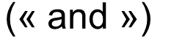
12.7.1 Developing an IPayable Hierarchy
U M L Diagram Containing an Interface
The U M L class diagram in Figure 12.10 shows the interface and class hierarchy used in our accounts-payable app.
The U M L distinguishes an interface from a class by placing the word “interface” in guillemets
above the interface name.
The U M L expresses the relationship between a class and an interface through a realization.

Slide 80
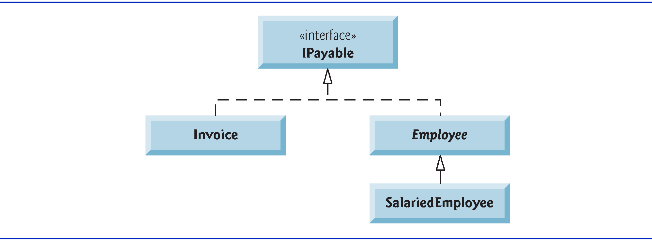
Figure 12.10 IPayable Interface and Class Hierarchy U M L Class Diagram

Slide 81
12.7.2 Declaring Interface IPayable
Interface IPayable is declared in Figure 12.11.

Slide 82
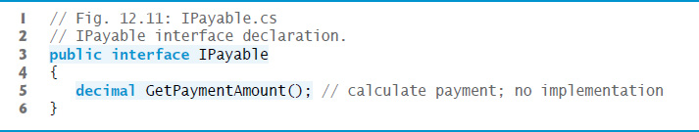
Figure 12.11 IPayable Interface Declaration

Slide 83
12.7.3 Creating Class Invoice
Class Invoice (Figure 12.12) represents a simple invoice that contains billing information for one kind of part.

Slide 84
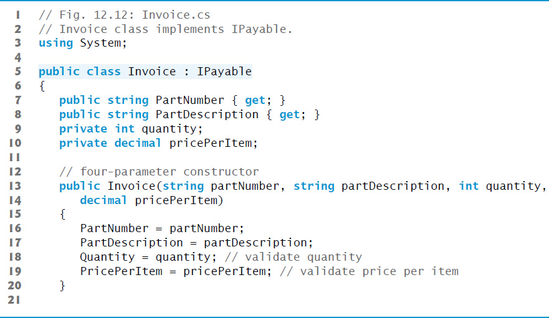
Figure 12.12 Invoice Class Implements Ipayable (1 of 4)

Slide 85
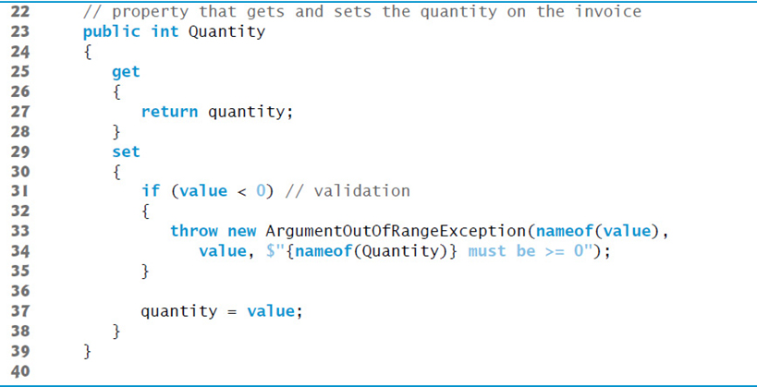
Figure 12.12 Invoice Class Implements Ipayable (2 of 4)

Slide 86
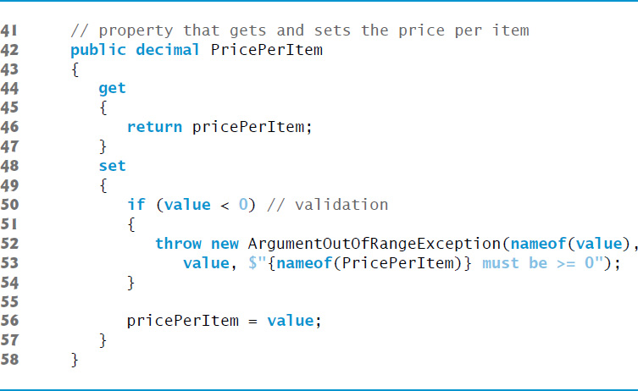
Figure 12.12 Invoice Class Implements Ipayable (3 of 4)

Slide 87
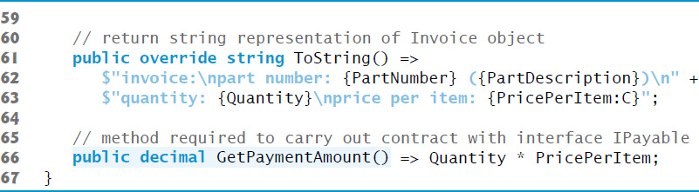
Figure 12.12 Invoice Class Implements Ipayable (4 of 4)

Slide 88
Software Engineering Observation 12.6
does not allow derived classes to inherit from more than one base class, but it does allow a class to inherit from a base class and implement any number of interfaces.

Slide 89
12.7.3 Creating Class Invoice
does not allow derived classes to inherit from more than one base class, but it does allow a class to implement any number of interfaces.
To implement more than one interface, use a comma-separated list of interface names after the colon (:) in the class declaration.
When a class inherits from a base class and implements one or more interfaces, the class declaration must list the base-class name before any interface names.

Slide 90
12.7.4 Modifying Class Employee to Implement Interface IPayable
Figure 12.13 contains the Employee class, modified to implement interface IPayable.
Notice that GetPaymentAmount simply calls Employee’s abstract method Earnings.
At execution time, when GetPaymentAmount is called on an object of an Employee derived class, GetPaymentAmount calls that class’s concrete Earnings method, which knows how to calculate earnings for objects of that derived-class type.

Slide 91
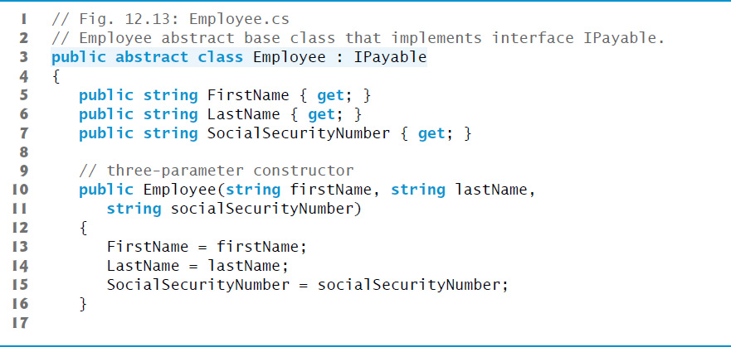
Figure 12.13 Employee Abstract Base Class that Implements Interface IPayable (1 of 2)

Slide 92
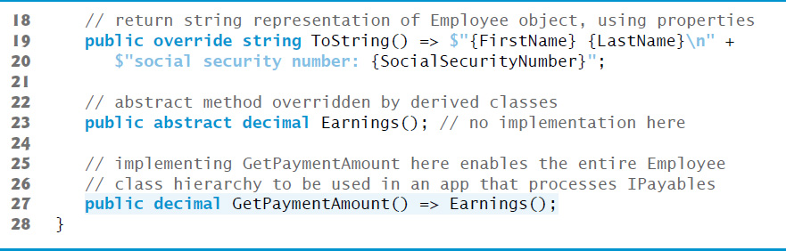
Figure 12.13 Employee Abstract Base Class that Implements Interface IPayable (2 of 2)

Slide 93
12.7.5 Modifying Class SalariedEmployee for Use with IPayable
When a class implements an interface, the same is-a relationship as inheritance applies.

Slide 94
Software Engineering Observation 12.7
Inheritance and interfaces are similar in their implementation of the is-a relationship. An object of a class that implements an interface may be thought of as an object of that interface type. An object of any derived classes of a class that implements an interface also can be thought of as an object of the interface type.

Slide 95
Software Engineering Observation 12.8
The is-a relationship that exists between base classes and derived classes, and between interfaces and the classes that implement them, holds when passing an object to a method. When a method parameter receives an argument of a base class or interface type, the method polymorphically processes the object received as an argument.

Slide 96
12.7.6 Using Interface IPayable to Process Invoices and Employees Polymorphically
PayableInterfaceTest (Figure 12.14 see slide 99) illustrates that interface IPayable can be used to processes a set of Invoices and Employees polymorphically in a single app.

Slide 97
Software Engineering Observation 12.9
All methods of class object can be called by using a reference of an interface type—the reference refers to an object, and all objects inherit the methods of class object.

Slide 98
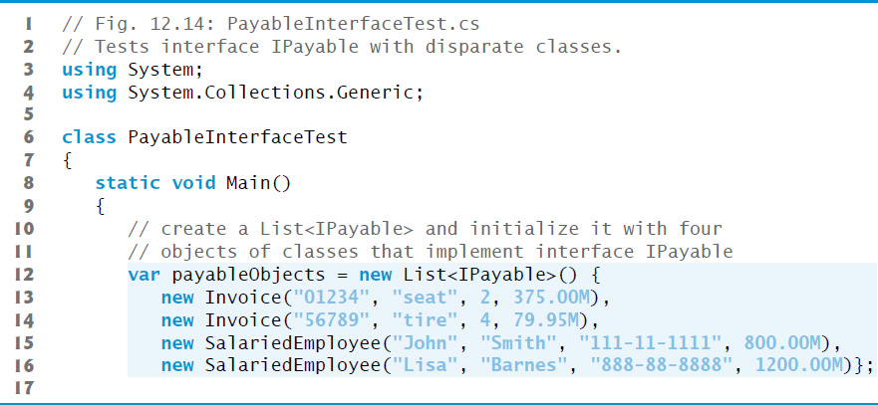
Figure 12.14 Tests Interface IPayable with Disparate Classes (1 of 3)

Slide 99
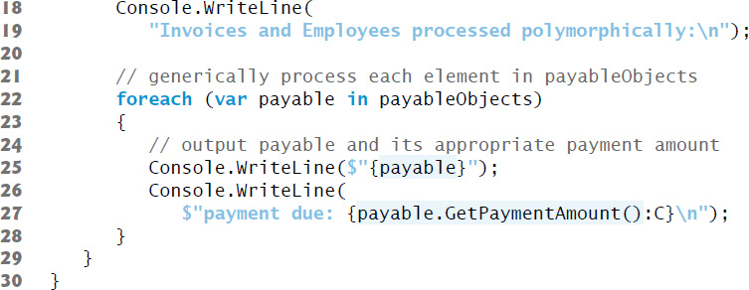
Figure 12.14 Tests Interface IPayable with Disparate Classes (2 of 3)

Slide 100
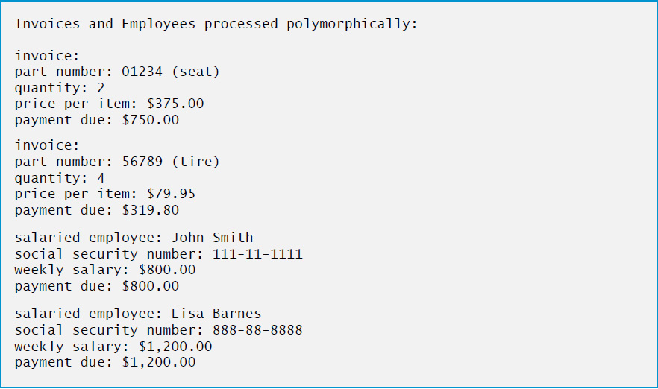
Figure 12.14 Tests Interface IPayable with Disparate Classes (3 of 3)

Slide 101
12.7.7 Common Interfaces of the .NET Framework Class Library
Figure 12.15 overviews several commonly used Framework Class Library interfaces.

Slide 102
Figure 12.15 Common Interfaces of the .N E T Framework Class Library (1 of 4)
Interface | Description
IComparable | C sharp contains several comparison operators For example, left angle bracket, left angle bracket equals, right angle bracket, right angle bracket equals, equals equals, exclamation point equals that allow you to compare simple-type values. Section 10.13 showed that you can overload these operators for your own types. Interface IComparable can be used to allow objects of a class that implements the interface to be compared to one another. The interface contains one method, CompareTo, which compares the object that calls the method to the object passed as an argument. Classes must implement CompareTo to return a value indicating whether the object on which it’s invoked is less than (negative integer return value), equal to (0 return value) or greater than (positive integer return value) the object passed as an argument, using any criteria you specify. For example, if class Employee implements IComparable, its CompareTo method could compare Employee objects by their earnings amounts. Interface IComparable is commonly used for ordering objects in a collection such as an array. We use IComparable in Chapter 20, Generics, and Chapter 21, Generic Collections; Functional Programming with L I N Q/P L I N Q.

Slide 103
Figure 12.15 Common Interfaces of the .N E T Framework Class Library (2 of 4)
Interface | Description
IComponent | Implemented by any class that represents a component, including Graphical User Interface (G U I) controls (such as buttons or labels). Interface IComponent defines the behaviors that components must implement. We discuss IComponent and many G U I controls that implement this interface in Chapter 14, Graphical User Interfaces with Windows Forms: Part 1, and Chapter 15, Graphical User Interfaces with Windows Forms: Part 2.

Slide 104
Figure 12.15 Common Interfaces of the .N E T Framework Class Library (3 of 4)
Interface | Description
IDisposable | Implemented by classes that must provide an explicit mechanism for releasing resources. Some resources can be used by only one program at a time. In addition, some resources, such as files on disk, are unmanaged resources that, unlike memory, cannot be released by the garbage collector. Classes that implement interface IDisposable provide a Dispose method that can be called to explicitly release resources that are explicitly associated with an object. We discuss IDisposable briefly in Chapter 13, Exception Handling: A Deeper Look. You can learn more about this interface at http://msdn.microsoft.com/library/ system.idisposable. The MSDN article Implementing a Dispose Method at http://msdn.microsoft.com/library/fs2xkftw discusses the proper implementation of this interface in your classes.

Slide 105
Figure 12.15 Common Interfaces of the .N E T Framework Class Library (4 of 4)
Interface | Description
IEnumerator | Used for iterating through the elements of a collection (such as an array or a List) one element at a time—the foreach statement uses an IEnumerator object to iterate through elements. Interface IEnumerator contains method MoveNext to move to the next element in a collection, method Reset to move to the position before the first element and property Current to return the object at the current location. We use IEnumerator in Chapter 21. All IEnumberable objects (Chapter 9) provide a GetEnumerator method that returns an IEnumerator object.

Slide 106

Copyright

